Slide 1
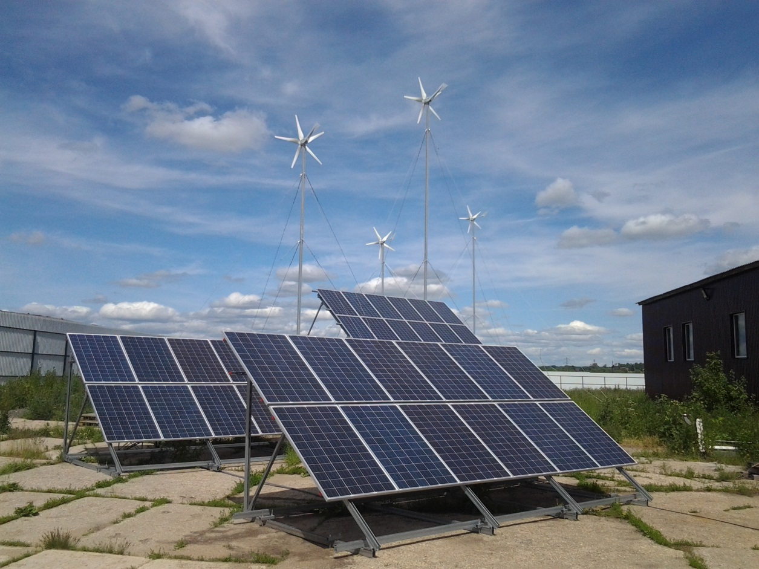
Hybrid autonomous container power plant with the use of wind and solar energy

Slide 2
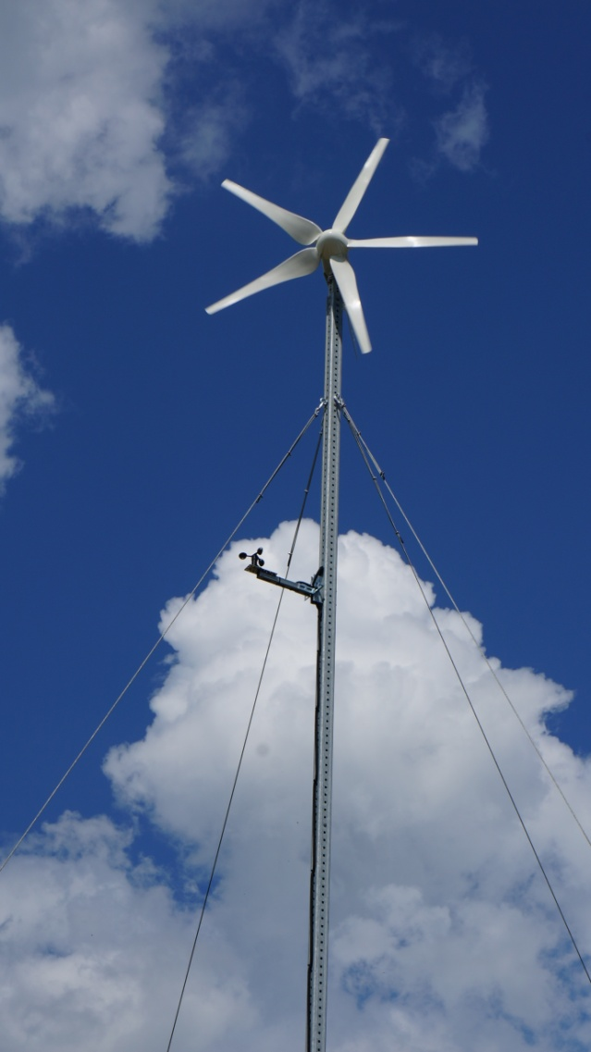
Hybrid autonomous container power plant (HACPP) – is a unique solution of the company LLC "Management and Financing" The main purpose of HAPP: Provide an object with electricity, first of all by using renewable "gratuitous" solar and wind energy.

Slide 3
Variants of use of HAPP
Autonomic variant:
Providing electricity to the remote object (fields, forests, mountains, islands, areas with difficult access).
Algorithm:
at first the use of renewable energy sources (RES): of sun and wind
in case of absence of wind/sun, the use of energy stored in the accumulator or start of diesel generator (DGS)
transition to renewable energy sources when a wind/sun appears

Slide 4
Variants of use of HAPP
With connection of external network:
Providing electricity to an object in "pumping" mode, i.e. partial or complete replacement of energy of external network by energy from RES.
Algorithm:
priority of use of renewable energy sources (RES): sun and wind - to replace the energy of external network
in case of failure of external network and lack of generation from RES, it is used the energy stored in the accumulator or DGS is turned on.

Slide 5
HAPP uses 4 sources of energy: solar panels, wind generators, diesel generator, external power networks. As an accumulator of energy the accumulator batteries (ACB) are used. The main mode of HAPP - is the generation of energy from sun and wind.
installed power of HAPP - 15 kW (~ 380/220V) - installed power of solar panels (SP) - 9.6 kW - installed power of wind generators (WEG) - 6.4 kW - power of accumulator batteries (ACB) - 1500 A*h (48 V)
installed power of diesel generator (DGS) - 20 kW (~ 380) - time of autonomic work of HAPP only from ACB with the load of 15 kW - 3 hours - work time of APP with the load of 30kW - 30 minutes
HAPP provides the consumers with electricity 24 hours a day, 365 days a year.

Slide 6
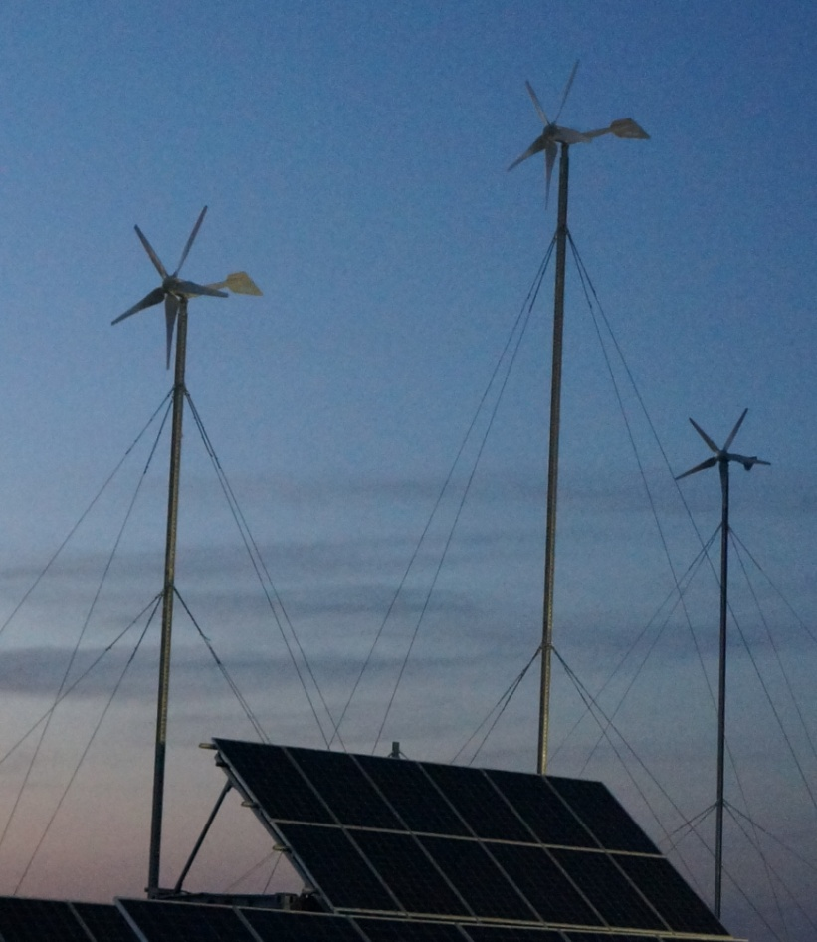
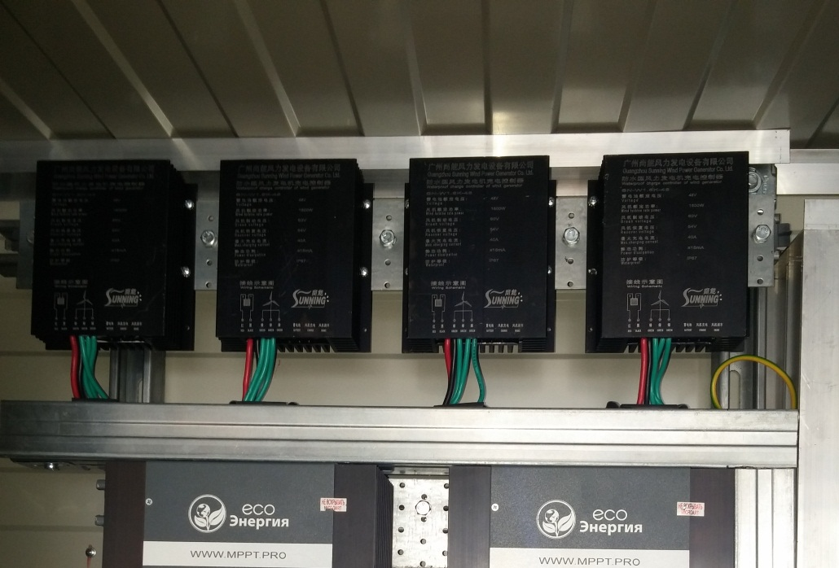
Energy sources of HAPP
Four wind energy generator (WEG) with charge controllers ACB made in China, kits of masts, stretch marks, screw piles.

Slide 7
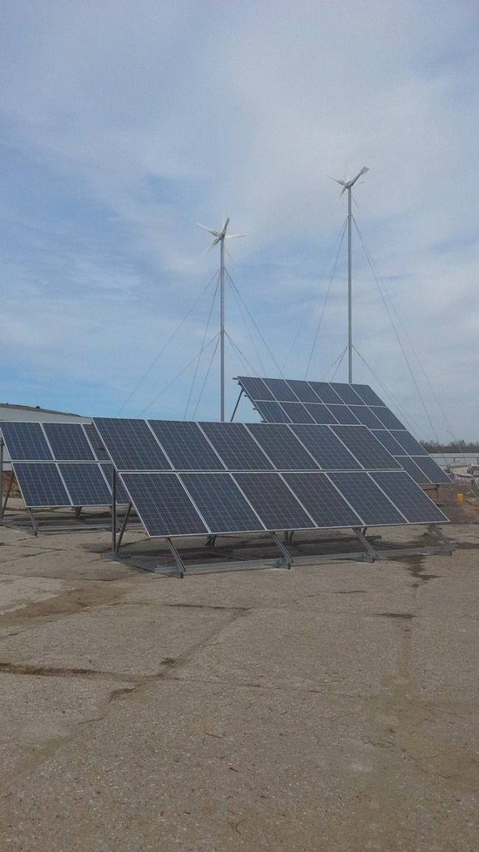
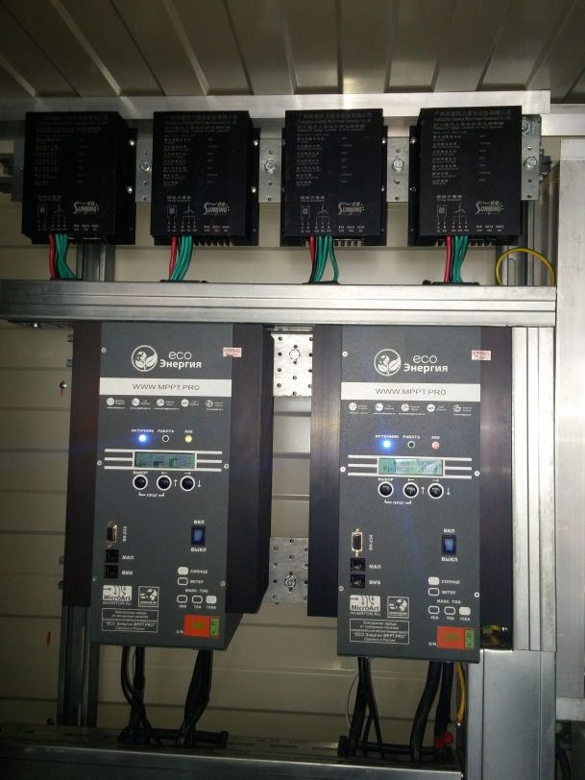
Energy Sources of HAPP
2. 48 solar panels (SP), with charge controllers ACB made in Russia, kits of metal structures to attach them.

Slide 8
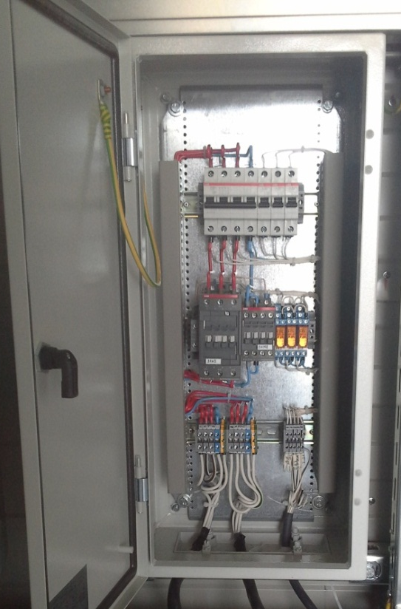
Energy Sources of HAPP
3. External Network
Connected to HAPP through feed-in panel. Algorithm of HAPP permits to save energy from the external network, using partial or complete substitution by the energy from RES.

Slide 9
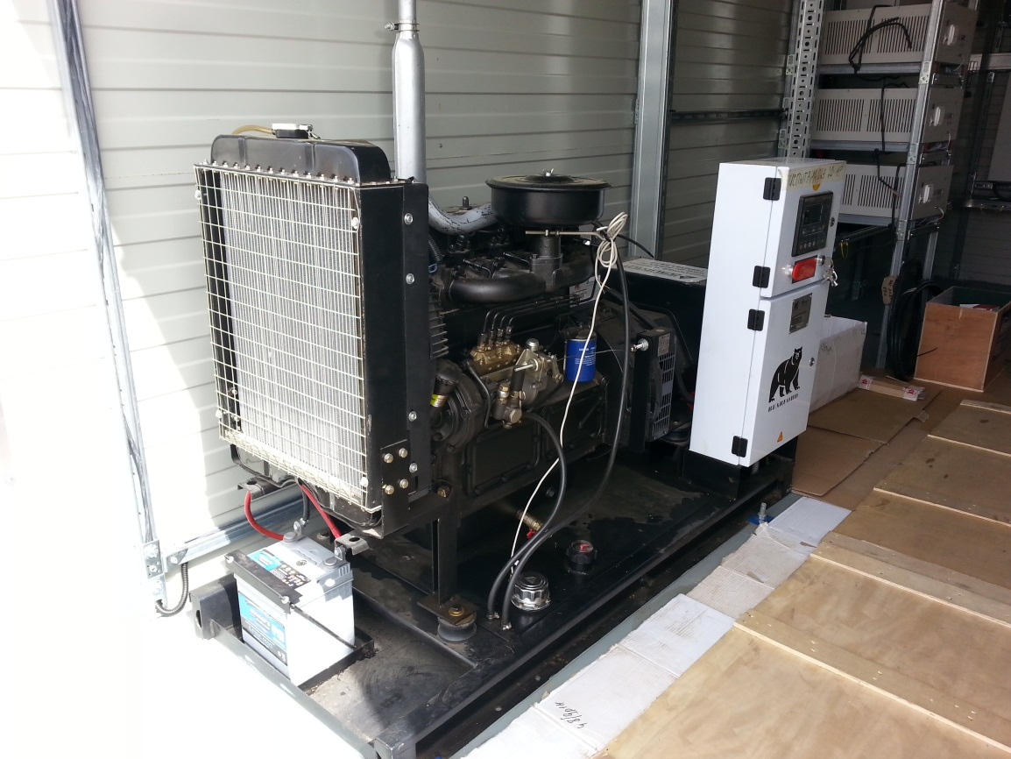
Energy Sources of HAPP
4. Diesel generator (DGS) Activated only when it is not enough energy from listed above sources and in the emergency mode.

Slide 10
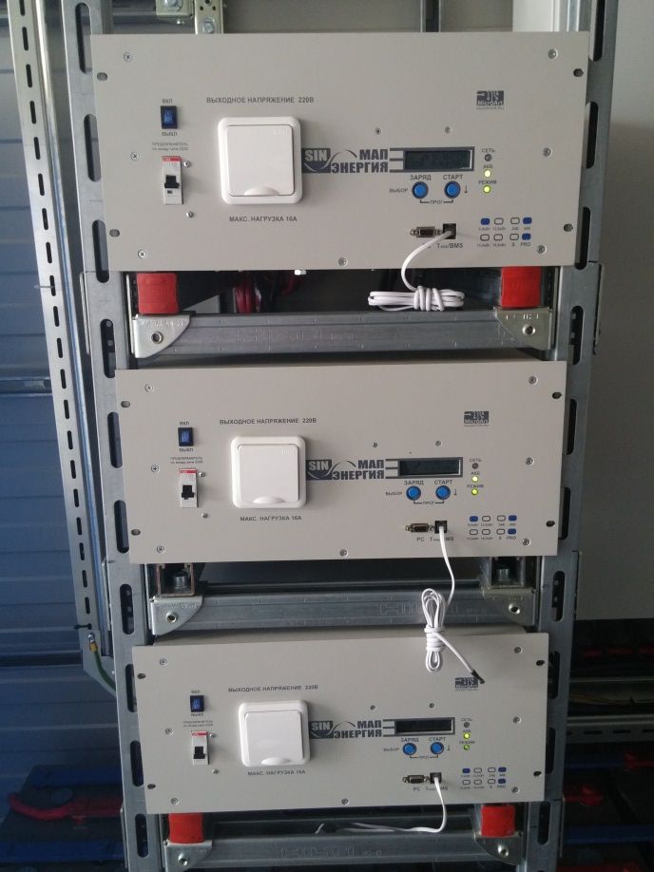
Main elements of HAPP
Charging system of accumulator battery (ACB) and of inversion made in Russia.

Slide 11
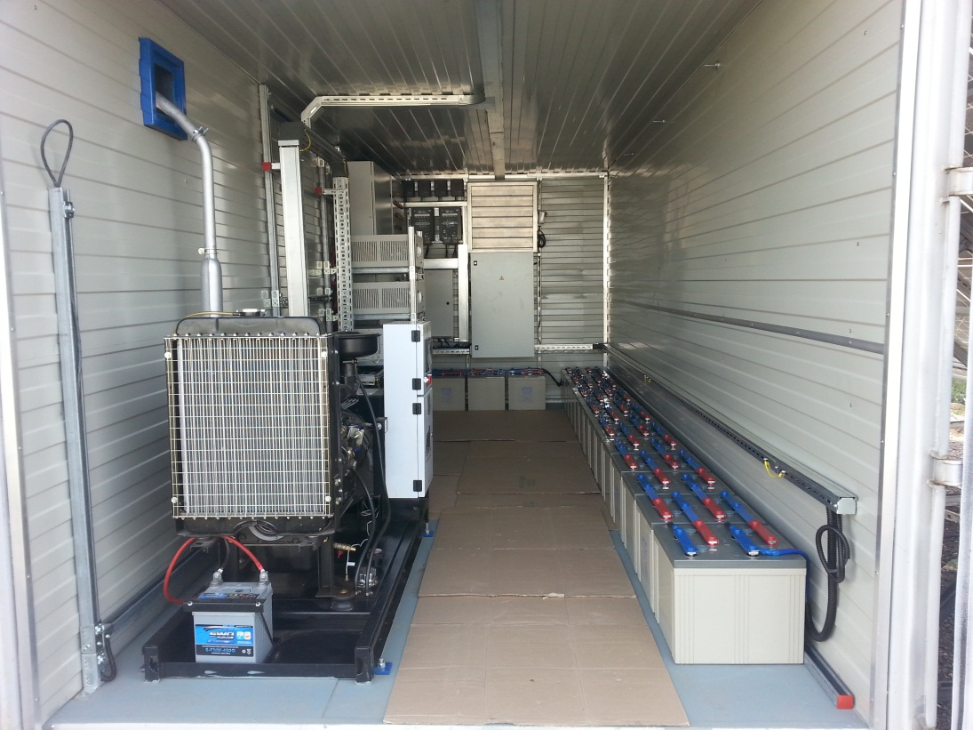
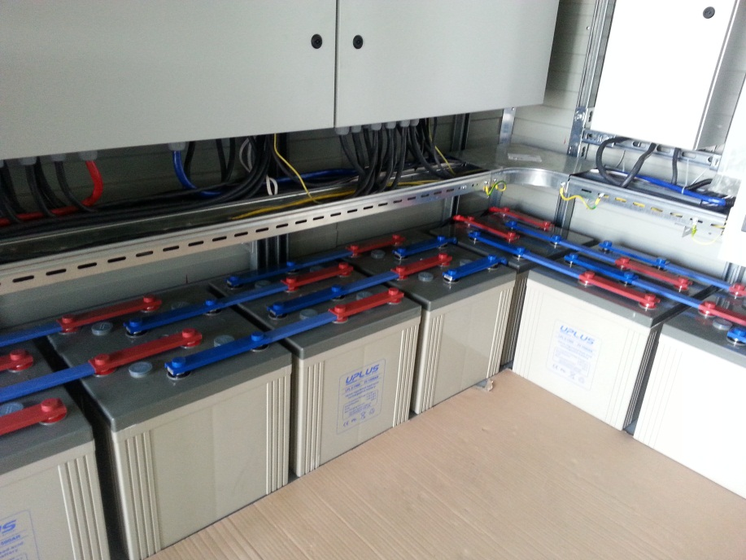
Main elements of HAPP
Energy storage system on accumulator batteries made in China.

Slide 12
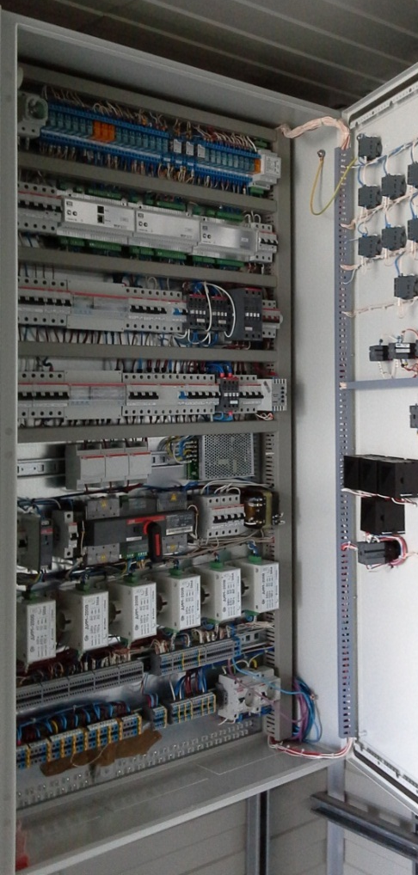
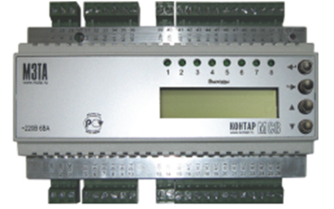
Main elements of HAPP
System of supervisory and intelligent control, including remote control by the Internet.
Specially developed by the company LLC "Management and Financing" the hardware-software complex of automatic data collection, data processing and transmission, control of generation, accumulation and inversion of electricity, as well as of service systems.

Slide 13
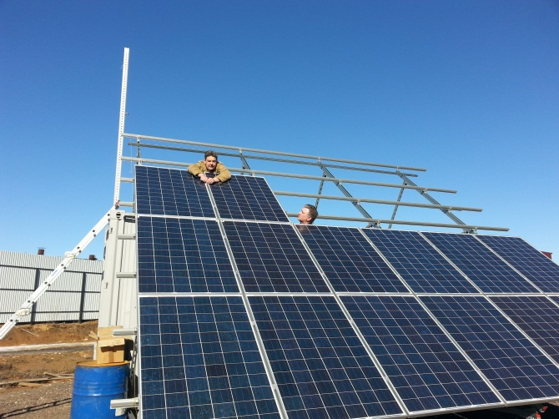
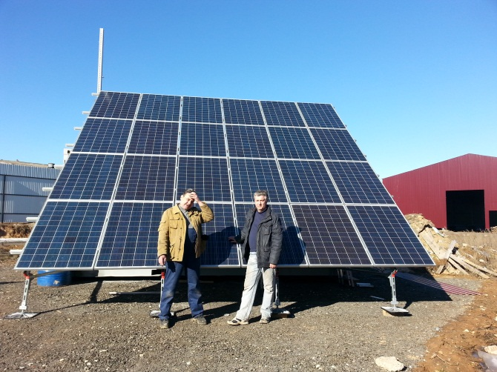
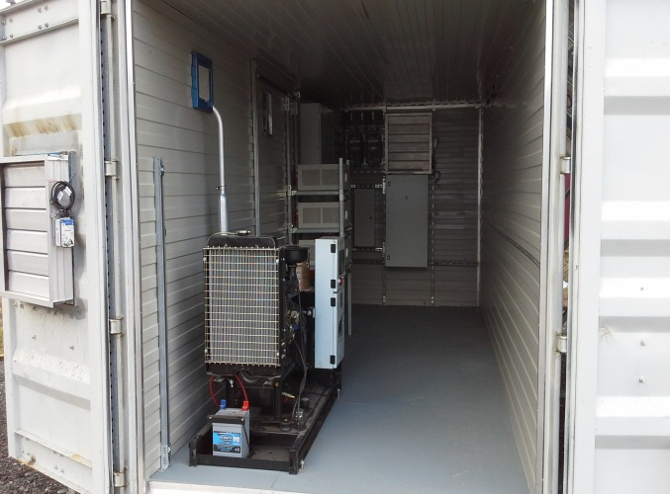
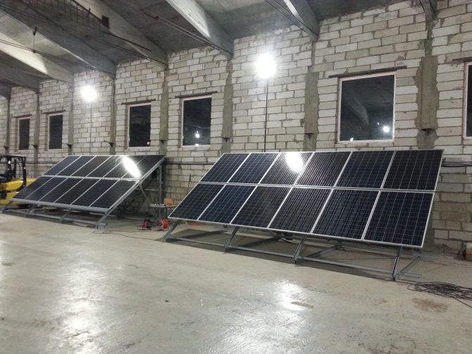
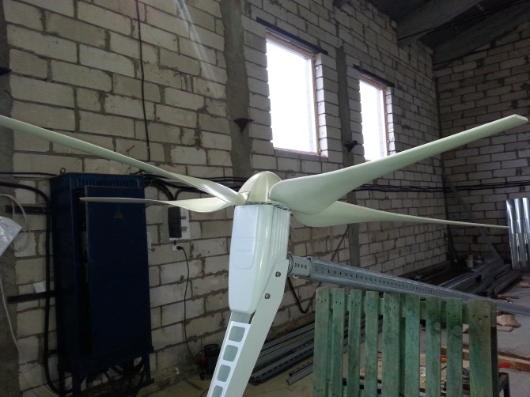
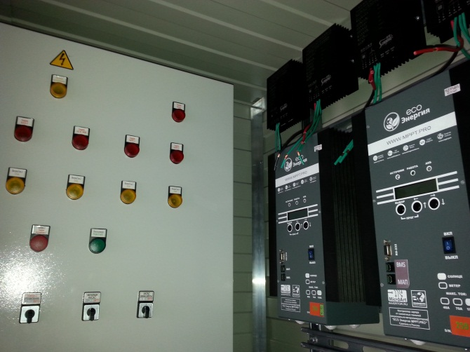
Assembling of HAPP

Slide 14
Our address: 121087, Moscow, street Barclay 6, bld. 5, office 412 Business center "Barclay Plaza"
Tel./fax:
+7 (495) 543-98-29
E-mail: info@upravfin.ru

